Slide 1



SignQuest
Teaching The ASL Using an Interactive Video System
Capstone Project Phase A
Students: Guy Shlomo Banbo & Elior Malik
Supervisor: Reuven Cohen

Slide 2

Table Of Content
The Problem
Existing Tools
Our Solution
Architecture
MediaPipe Holistic
The Model (LSTM)
The Dataset
The Teaching Method
Use Case Diagram
Activity Diagram
User Interface
Evaluation
Testing
Constraints
Challenges

Slide 3
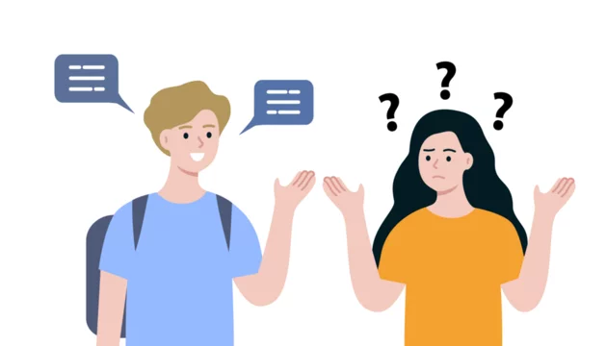
The Problem
There is a lack of using sign language among deaf people
The general population's unfamiliarity with sign language poses a significant communication barrier for those who are hearing impaired.
The availability and quality of educational resources are limited
Most of the current solutions don’t offer feedback on the user’s gestures
Notes:
The sign language is important way for deaf people to communicate, yet many of them don’t use it a lot(or don’t even know it). In addition, the people around them usually don’t know sign language at all, which creates a communication barrier for deaf people. The cause for that problem is the fact that the access to good resources for learning sign language is usually limited. Most of the current solutions for learning sign language alone don’t offer feedback and aren’t enough to solve the problem.

Slide 4
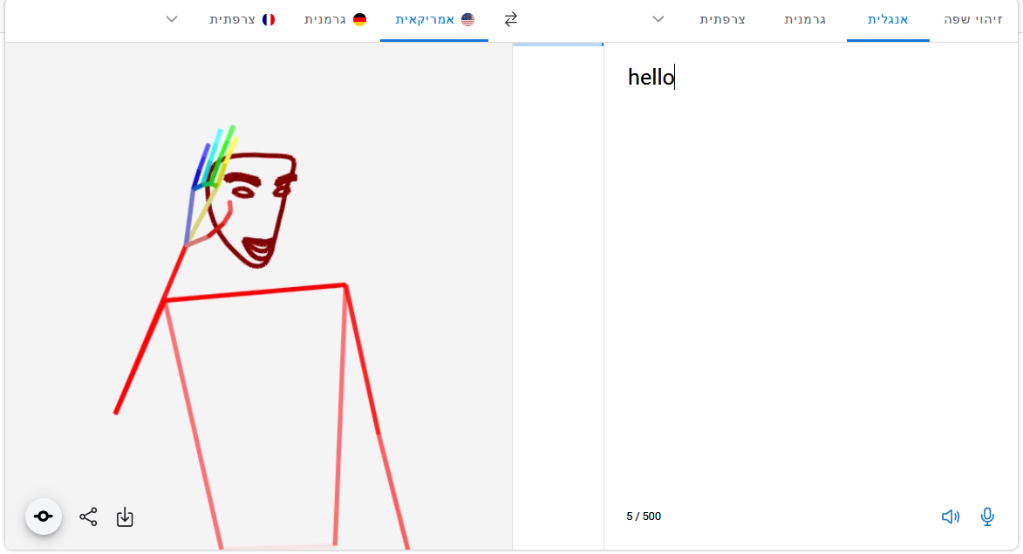
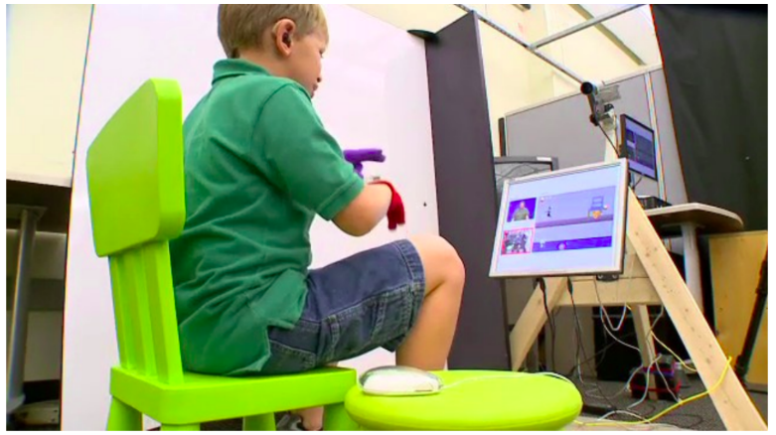
Existing Solutions
Expert tutors - online or frontal teaching by expert tutors
Video lessons - online ASL teaching by video lessons
Teaching games - teaching ASL by interactive games
Translation tools - translation from text to sign language and vice versa.
CopyCat
sign.mt
Notes:
there are a few existing solutions- teachers, online video lessons, translation tools(like sign.mt) and games for learning sign language(like copycat- a kids game that originally used special gloves to recognize gestures).However, there aren’t many solutions that enable the user to learn alone and get feedback on his gestures.

Slide 5
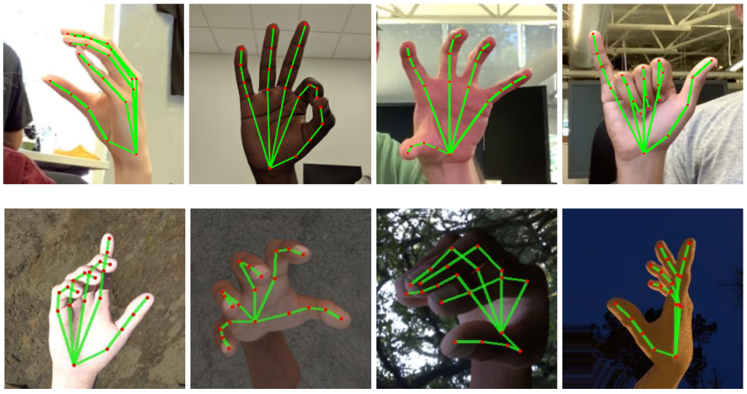
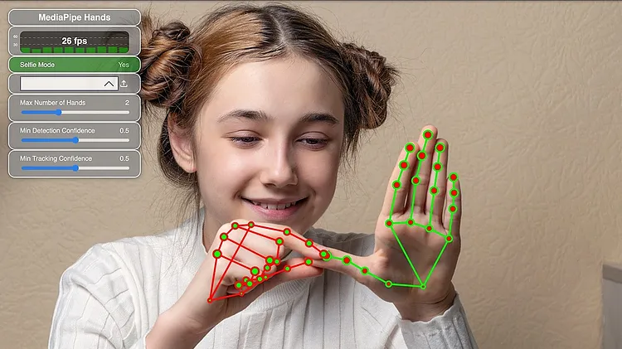

Our Solution
An application that provides an easy and intuitive way to learn the American sign language
Real time video gesture recognition using machine learning
Immediate feedback when successfully performing a gesture
Notes:
the solution is an app for learning asl that will recognize gestures and give the user a feedback when successfully performing the correct gesture.

Slide 6
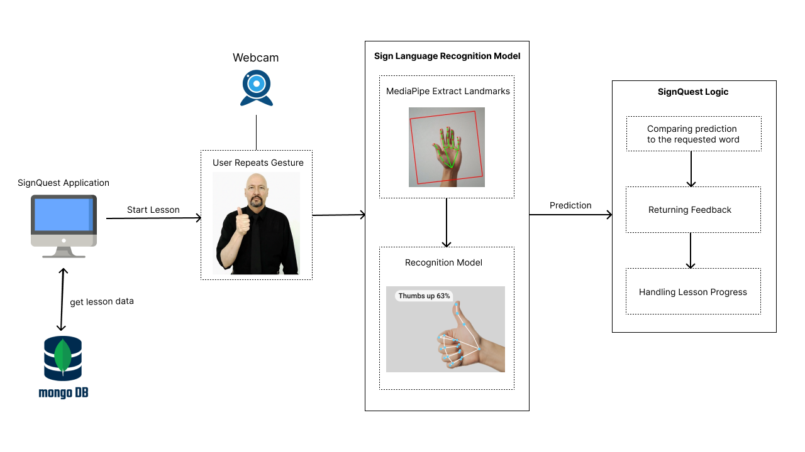
Architecture
Notes:
the application will use a mongodb database to store the lessons, at the start of a lesson the user will repeat an asl gesture, mediapipe will extract the landmarks and model will predict what is the gesture. if the predicted word is the wanted word, the user will get a feedback and the lesson will continue.

Slide 7
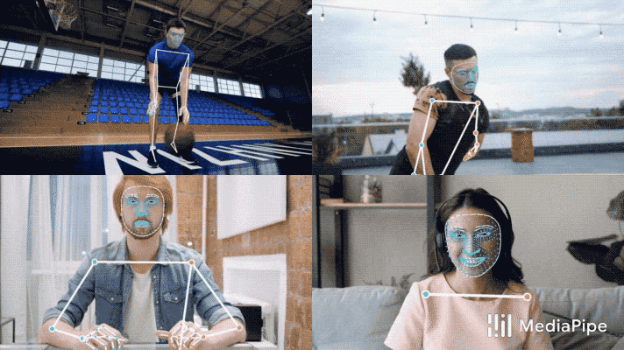

MediaPipe Holistic
MediaPipe Holistic - allows to extract signer’s gesture landmarks.
The MediaPipe holistic provides the following landmarks:
Hand - These landmarks can be used to track hand gestures, hand poses, and interactions with objects.
Pose - These landmarks can be used for pose estimation, tracking body movements, and analyzing body gestures.
Facial - These landmarks can be used for facial recognition, facial expression analysis, and facial motion tracking, among other applications.
Hand Landmarks
Example of MediaPipe Holistic
Notes:
Mediapipe is a framework that enables the extraction of important landmarks of asl gestures from video. the landmarks will be used to train a recognition model

Slide 8
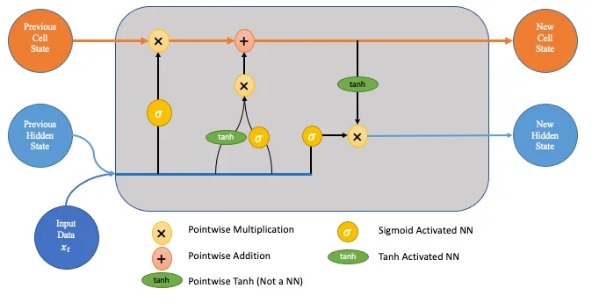
Model
Uses an LSTM machine learning model
LSTM is a variant of RNN, which uses sequential data or time series data
Adds special memory block called cells in hidden layer
Cells controlled by input gate, output gate, and forget gate
Enables layer to remember helpful information over longer timelines
Well-suited for modeling sequential data like sign language videos
LSTM Architecture
Notes:
Can capture long-term dependencies and temporal patterns effectively

Slide 9
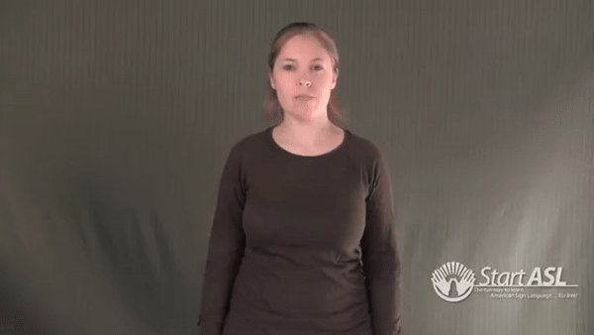
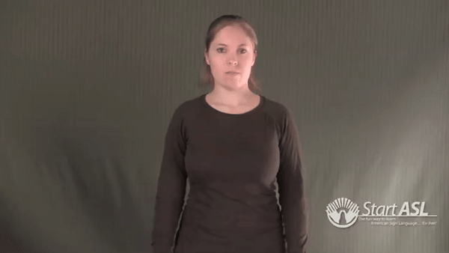
Dataset
The dataset will contain videos of ASL gestures
the videos will be collected mainly form 2 sources: WLASL, SignASL
Learn
Sign Language
Notes:
we chose those sources because they contained more videos and with different signers, backgrounds etc.

Slide 10
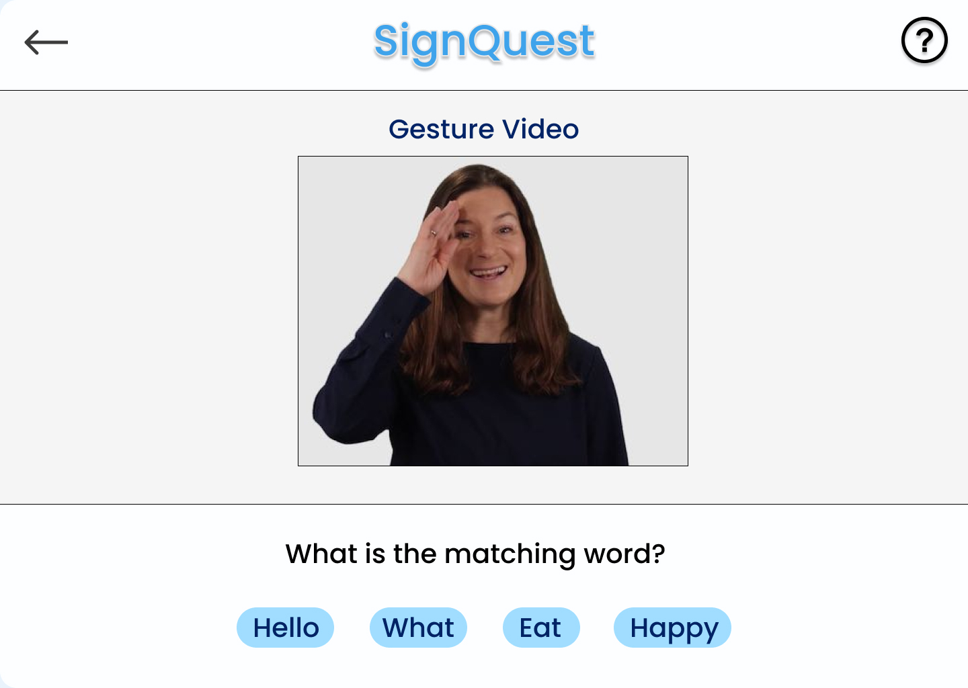
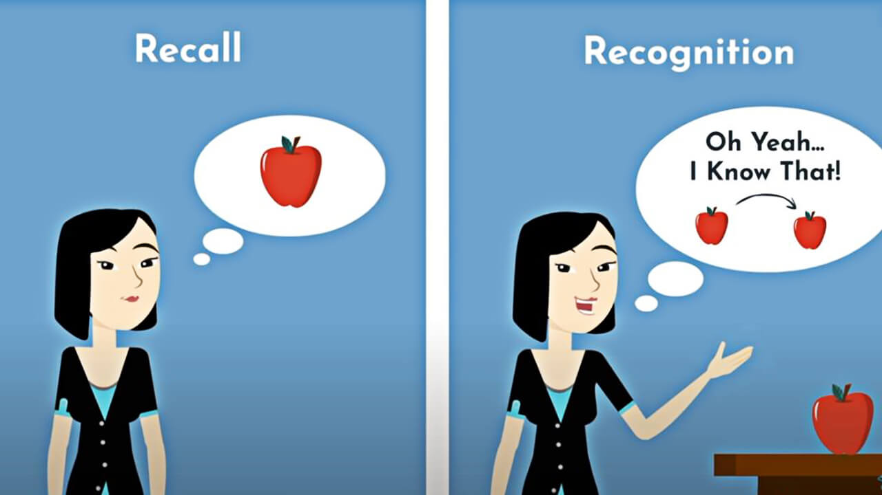
Teaching Method
The app will include different types of exercises:
Repeating a gesture
Choosing the word that matches a gesture
Typing the word that matches a gesture
Performing a gesture of a missing word in a sentence
The different types of exercises are based on memory recognition and recall to ensure an effective learning process.
At the end of each lesson, a score for the lesson will be calculated

Slide 11
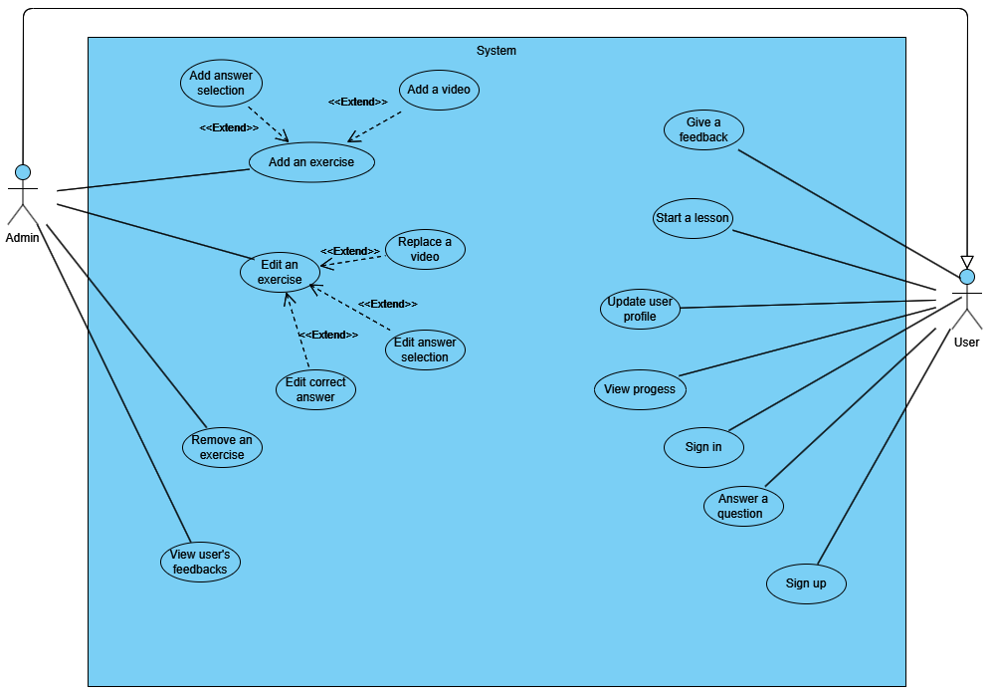
Use Case Diagram

Slide 12
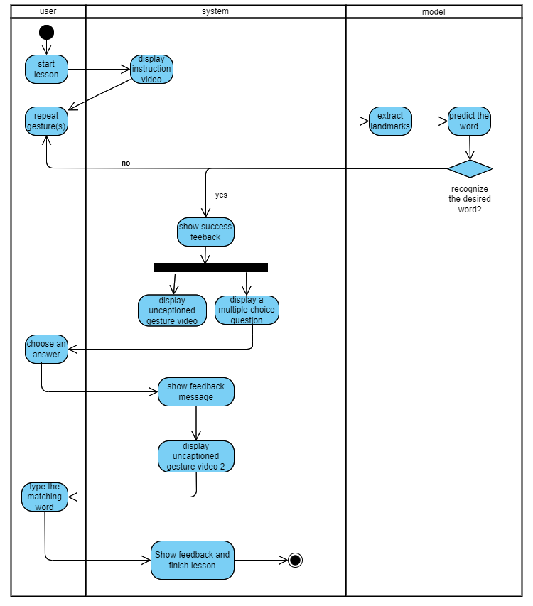
Activity Diagram

Slide 13
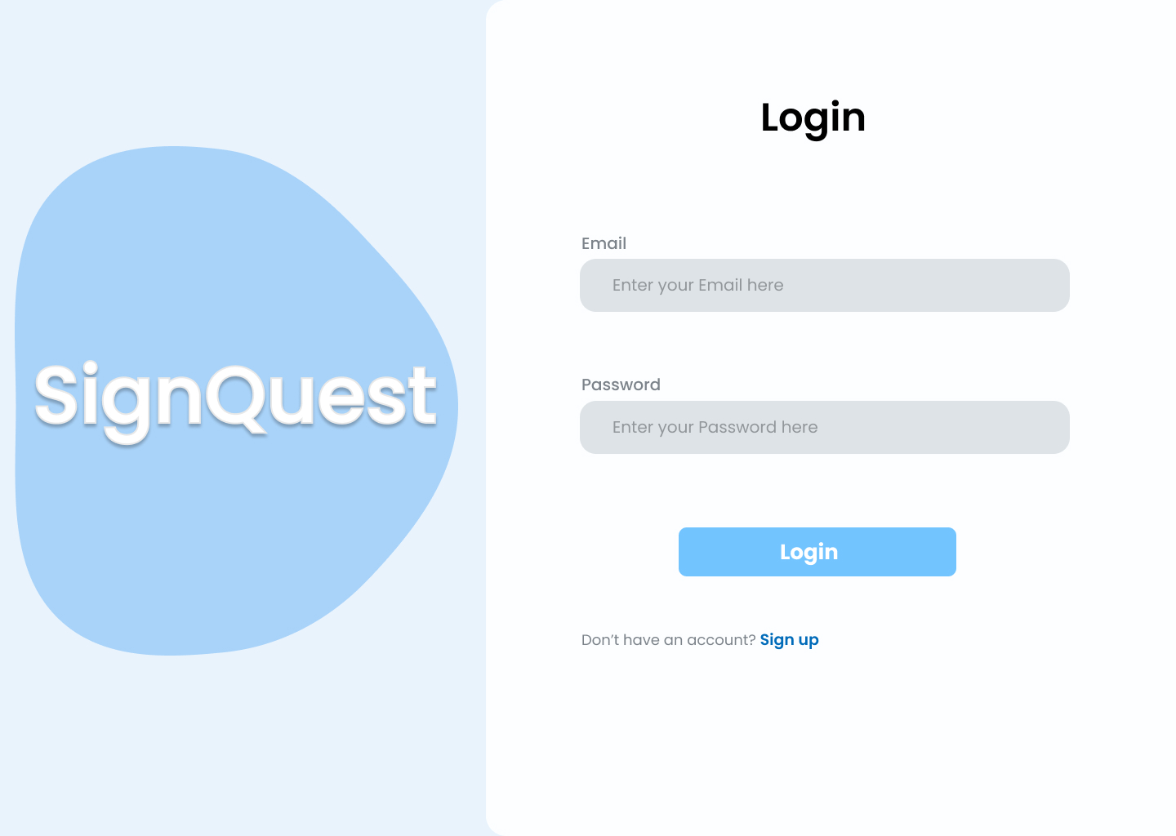
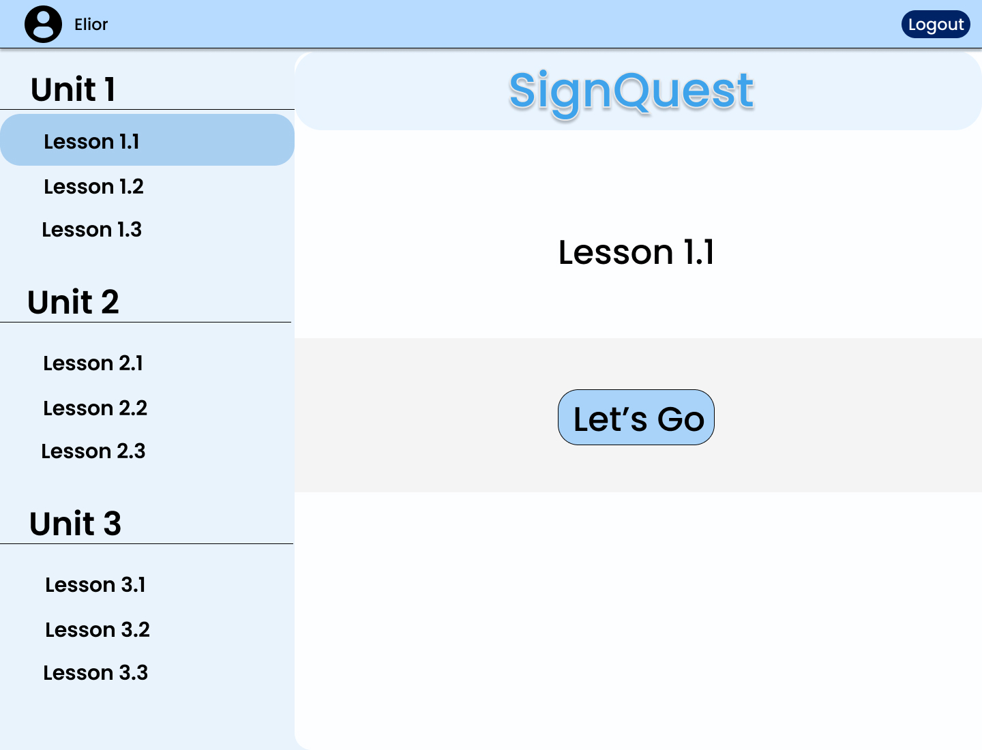
User Interface
Login Page
Homepage

Slide 14
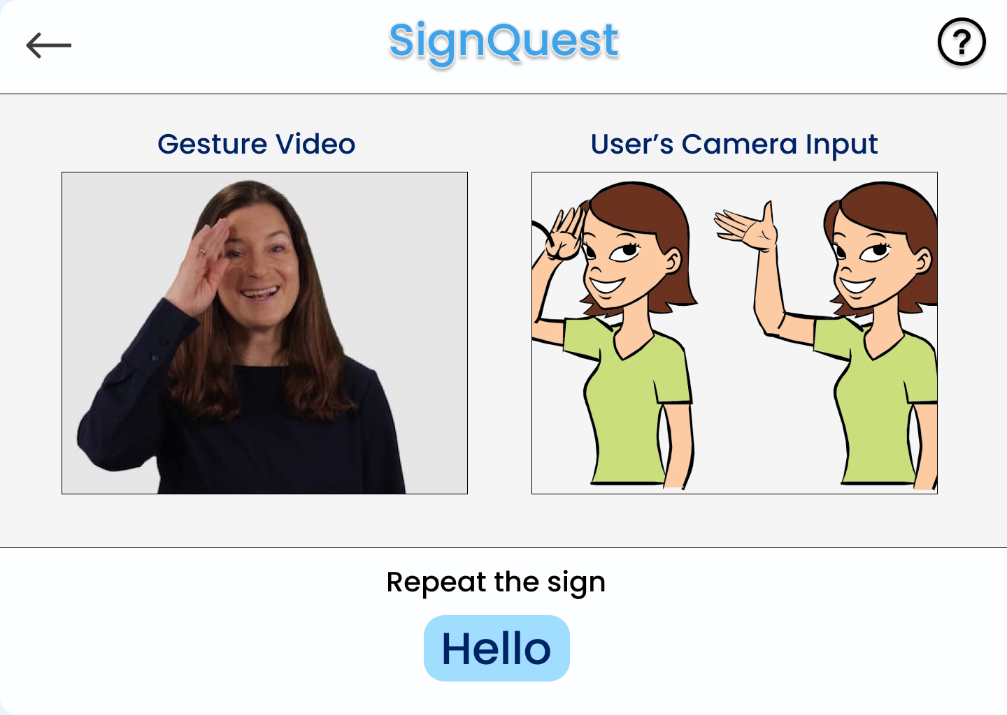
User Interface
Repeat a gesture exercise
Choose correct word exercise

Slide 15
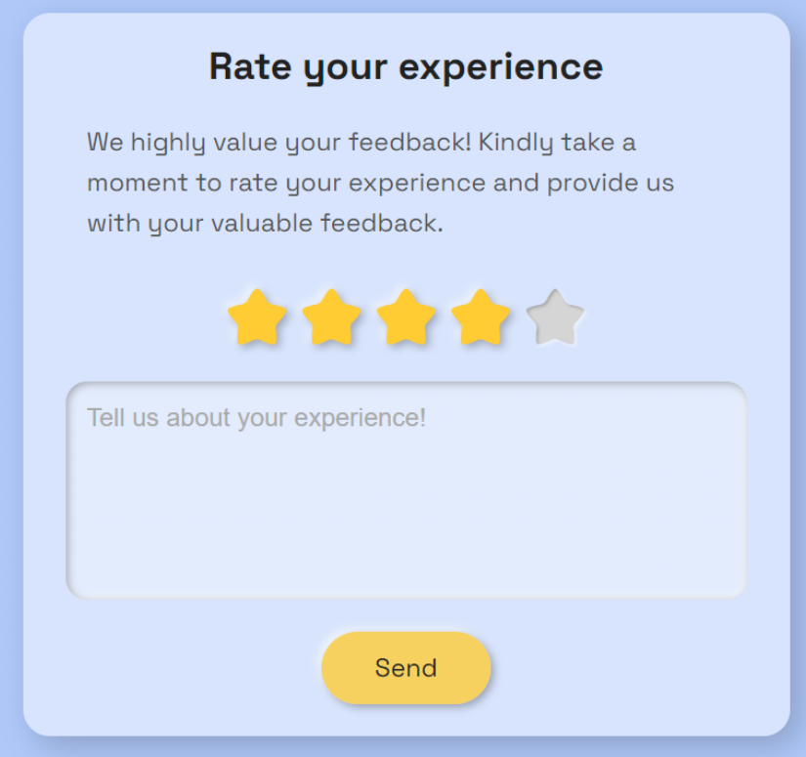
Evaluation
The evaluation of the app will focus on accuracy, performance and user experience:
Accuracy will be evaluated using the test set
The speed of execution in real-time from detection to prediction
the ability of the users to learn ASL words will be evaluated by their scores
user experience will be evaluated based on users feedbacks

Slide 16
Testing
ID | Action | Expected result
1 | Signing up | Success message New user created in the database. page redirects to login
2 | Signing in | Success message File with user credentials created page redirects to homepage
3 | User updating his profile | User profile is updated with the new information.
4 | User viewing homepage | showing all available lessons and units showing toolbar
5 | User answering a question | giving a feedback according to the answer moving to the next question
6 | User viewing his progress | Correctly shows the user's progress: completed units,lessons ,words and scores of completed lessons.
7 | User watching an instruction video | Correctly shows instruction video corresponding to the word
8 | User submit a feedback | Success message New feedback is added to the DB with a rating and review
9 | Admin adding an exercise | Success message New exercise is added to the DB with a type, correct answer, video link and list of possible answers
10 | Admin editing an exercise | Success message the new exercise information updated in the DB with a type, correct answer, video link and list of possible answers
11 | Admin viewing user’s feedback | All user’s feedback will be shown, with review, rating and date.
12 | User performs sign language gestures | accurately recognizing users’ performed gesture showing feedback to the user

Slide 17
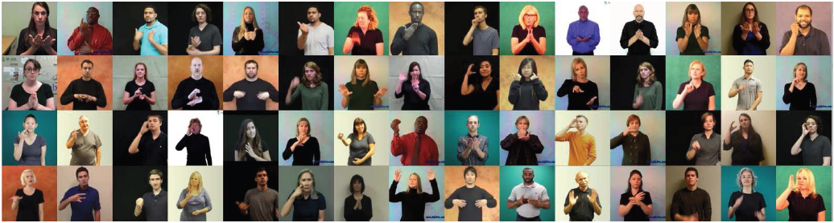
Constraints
In most of the videos in the chosen datasets the signer is standing
The user will have to distance himself from the screen in order to get an accurate recognition
in many videos in WLASL the signer is standing
Notes:
The consequence of the first constraint is that using the app while sitting may result in difficulty of the recognition model to correctly predict the user’s hand gestures

Slide 18
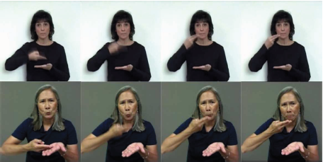
Challenges
High computational resources required for training LSTM model
Number of videos per word in existing datasets is limited
Creating an effective Teaching Method
Gestures with multiple meanings
The same sign represents different words “Rice” (top) and “soup” (bottom)
Notes:
The consequence of the first constraint is that using the app while sitting may result in difficulty of the recognition model to correctly predict the user’s hand gestures

Slide 19
Thank you
Any Questions?

